Slide 1

Forecast: Bike Rentals
Project Guide Presented by:
Professor Mohammad Zia Group number: 16
Vikas Deep Shukla

Slide 2

Objective
Minimizing global warming
Enhancing the use of clean transport method like bike sharing system
Analyzing the features effecting bike rental system
Providing conclusion for increasing bike rental

Slide 3
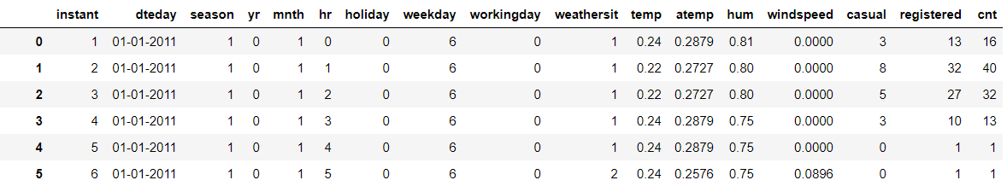
Overview of Dataset
The data set contains two-year historical log corresponding to years 2011 and 2012 from Capital Bikeshare system, Washington D.C., USA which is available on http://capitalbikeshare.com/system-data.
There are total 17 features present in the dataset.

Slide 4
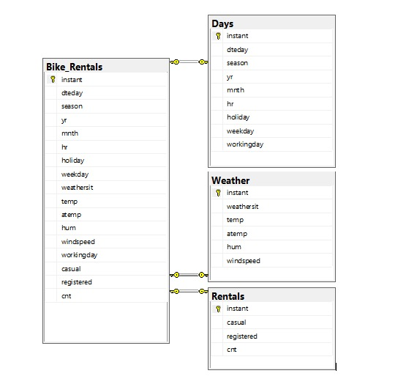
Entity Relationship diagram

Slide 5

Overview of Problem
This project is aimed at analyzing the parameters on which bike rentals improves its performance.
The project evaluates the predictive performance of all the train data.

Slide 6
Insights and Modelling
Moving towards Jupyter notebook

Slide 7
Conclusion
Bike rental counts are higher during summer and fall.
Bike rental are higher during office opening and closing hours.
With increase in temperature bike rentals increase and decrease with increase in humidity.
As weather becomes harsh bike rentals decrease.
Percent of casual rides are more during nonworking days as compared to working days.

Slide 8
Suggestions
During winter and spring season, bike rental companies can run discount coupon to increase sales.
During office opening and closing hours, bike rental companies should increase their inventory to meet demand.
Bike rental companies can provide GPS tracking for customer security.
Companies can attract casual riders by providing free membership coupons.

Slide 9
Thank you

